Slide 1
Java Server Page(JSP)

Slide 2
Introduction to JSP
JSP technology is used to create web application just like Servlet technology.
It can be thought of as an extension to servlet because it provides additional functionality than servlet such as expression language, JSTL, etc.
A JSP page consists of HTML tags and JSP tags.
The JSP pages are easier to maintain than servlet because we can easily separate designing from the business logic part.

Slide 3
Advantages of JSP
vs. Active Server Pages (ASP)
The advantages of JSP are twofold:-
First, the dynamic part is written in Java (not Visual Basic or other MS specific language), so it is more powerful and easier to use.
Second, it is portable to other operating systems and non- Microsoft Web servers also.
vs. JavaScript
JavaScript can generate HTML content dynamically on the client-side but can hardly interact with the web server to perform complex tasks like database access and image processing, etc.

Slide 4
Advantage of JSP over Servlet
1) Extension to Servlet
JSP technology is the extension to servlet technology. We can use all the features of servlet in JSP. In addition, we can use implicit objects, predefined tags, expression language and Custom tags in JSP, that makes JSP development easy.
2) Easy to maintain
JSP can be easily maintained because we can easily separate our business logic from the presentation logic. In servlet technology, we mix our business logic with the presentation logic.
3) Fast Development: No need to re-compile and re-deploy
If JSP page is modified, we don't need to re-compile and deploy the project again. But, the servlet code needs to be updated and re-compiled if we have to change the look and feel of the application.
4) Less code than Servlet
In JSP, we can use a lot of tags such as action tags (jsp:forward), JSTL(c:out, c:import), custom tags etc. that reduces the code. Moreover, we can use Expression Language, implicit objects etc.

Slide 5
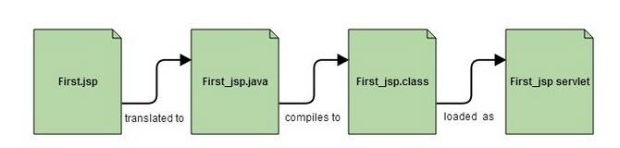
Life cycle of a JSP Page
At the end a JSP becomes a Servlet:
JSP pages are converted into Servlet by the Web Container.
The Container translates a JSP page into servlet class source(.java) file and then compiles into a Java Servlet class file.

Slide 6
Life cycle of a JSP Page
The JSP pages have following phases:
Compilation of JSP Page
Class loading (class file is loaded by the classloader)
Instantiation (Object of the Generated Servlet is created).
Initialization ( jspInit() method is invoked by the container).
Request processing ( _jspService() method is invoked by the container).
Destroy ( jspDestroy() method is invoked by the container).

Slide 7
JSP Compilation
When a browser asks for a JSP page, the JSP engine first checks to see whether it needs to compile the page.
If the page has never been compiled to a Servlet, only then JSP engine compiles the page.
The compilation process involves three steps −
Parsing the JSP.
Converting the JSP into a servlet.
Compiling the servlet.

Slide 8
JSP Initialization
When web container loads a JSP it invokes the jspInit() method before servicing any requests.
If you need to perform JSP-specific initialization, then override the jspInit() method −
public void jspInit()
{
// Initialization code...
}
Typically, initialization is performed only once and as with the Servlet‘s init() method, we generally initialize database connections, open files, and create lookup tables in the jspInit() method.

Slide 9
JSP Execution (main logic)
This phase of the JSP life cycle represents all interactions with requests until the JSP is destroyed.
Whenever a browser requests a JSP and the page has been loaded and initialized, then the JSP engine invokes the _jspService() method in the JSP.
The _jspService() method as follows −
void _jspService(HttpServletRequest req, HttpServletResponse res)
{
// Service handling code...
}
This method is responsible for generating the response for that request and is also responsible for generating responses to all of the HTTP methods, i.e, GET, POST, DELETE, PUT, etc.

Slide 10
JSP Cleanup
The destruction phase of the JSP life cycle begins when a JSP is being removed from use by the web container.
The jspDestroy() method is the JSP equivalent of the destroy() method for Servlets.
The jspDestroy() method has the following form −
public void jspDestroy() {
// cleanup code goes here.
}

Slide 11
Creating a JSP Page
A JSP page looks similar to an HTML page, but a JSP page also has Java code in it (embedded within scriplet tag ).
We can put any regular Java Code in a JSP file using a scriplet tag which start with <% and ends with %>.
JSP pages are used to develop dynamic responses.

Slide 12
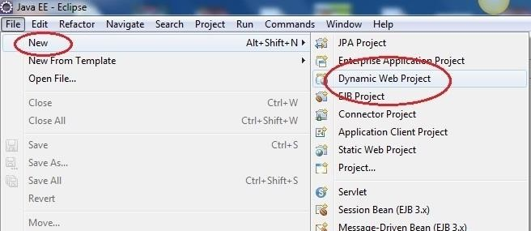
Creating a JSP Page
Open Eclipse, Click on New → Dynamic Web Project

Slide 13
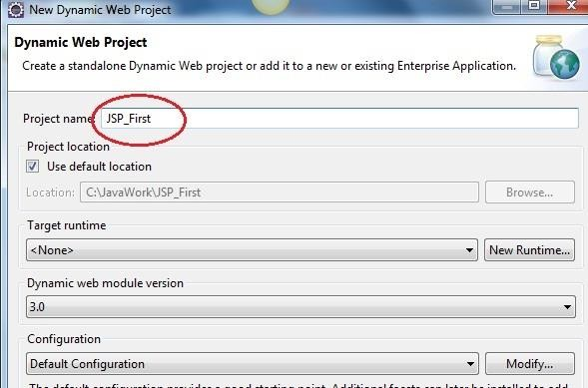
Creating a JSP Page
Give a name to your project and click on OK

Slide 14
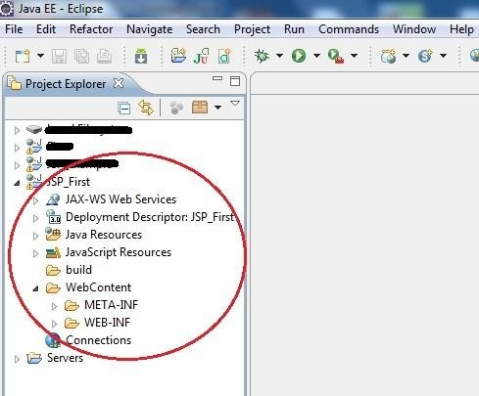
Creating a JSP Page
You will see a new project created in Project Explorer

Slide 15
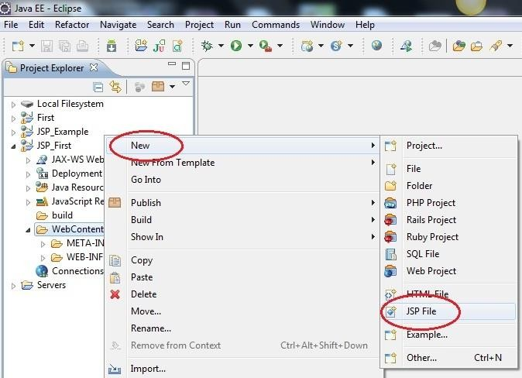
Creating a JSP Page
To create a new JSP file right click on Web Content directory, New → JSP file

Slide 16
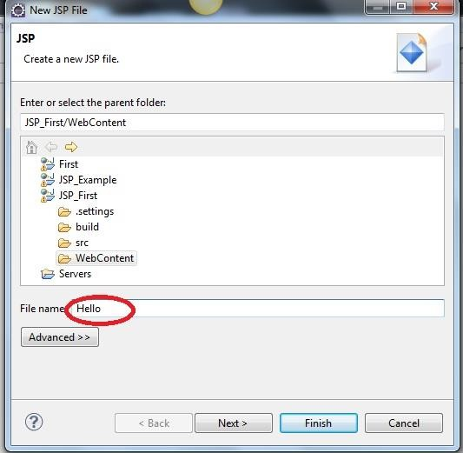
Creating a JSP Page
Give a name to your JSP file and click Finish.

Slide 17
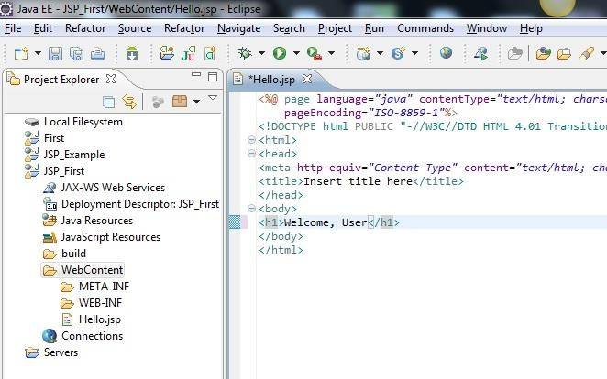
Creating a JSP Page
The complete HTML and the JSP code, goes inside the <body> tag, just like HTML pages.

Slide 18




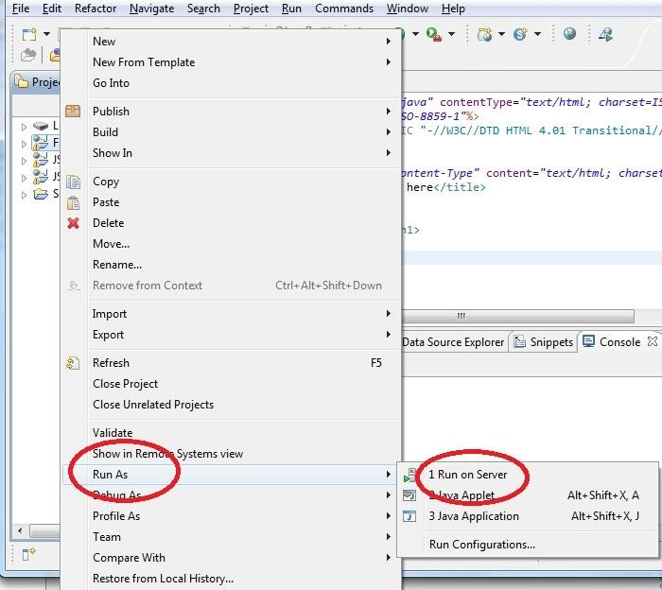
Creating a JSP Page
To run your project, right click on Project, select Run As → Run on Server

Slide 19
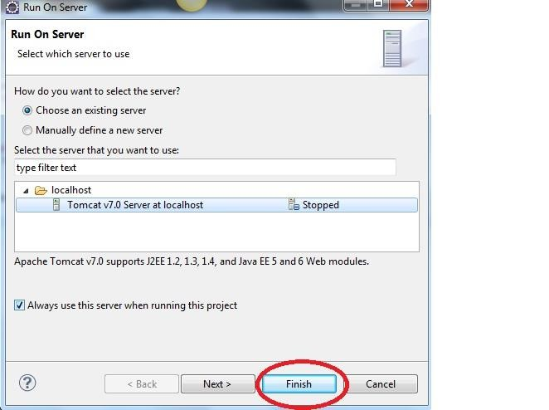
Creating a JSP Page

Slide 20

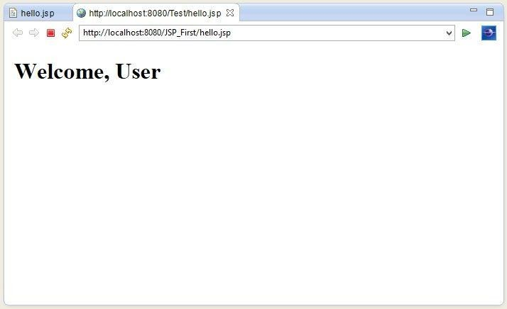
Creating a JSP Page
See the Output in your browser.

Slide 21
Elements of JSP
Scripting Element | Example
Comment | <%-- comment --%>
Directive | <%@ directive %>
Declaration | <%! declarations %>
Scriptlet | <% scriplets %>
Expression | <%= expression %>

Slide 22
JSP Comments
JSP comment marks text or statements that the JSP container should ignore.
Syntax of the JSP comments −
<%-- This is JSP comment --%>
Example shows the JSP Comments −
<html>
<body>
<h2>A Test of Comments</h2>
<%-- This comment will not be visible in the page source --%>
</body>
</html>

Slide 23
JSP Directives
The jsp directives are messages that tells the web container how to translate a JSP page into the corresponding Servlet.
It usually has the following form −
<%@ directive_name attribute = "value" %>
There are three types of directives:
page directive
include directive
taglib directive

Slide 24
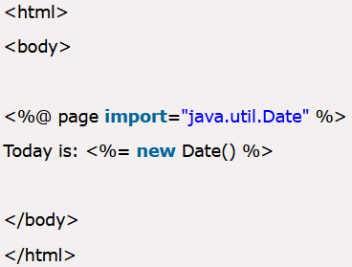
Page directive:
The page directive defines attributes that apply to an entire JSP page.
<%@ page attribute="value" %>
Following are the Page directive attributes:
import:
The import attribute is used to import class, interface or all the members of a package.
It is similar to the import statement in java.

Slide 25
b. extends:
The extends attribute defines the parent class that will be inherited by the generated servlet class.
c. info:
This attribute simply sets the information of the JSP page which is retrieved later by using getServletInfo() method of Servlet interface
<html>
<body>
<%@ page info= “sample page by VSG” %>
</body>
</html>
The web container will create a method getServletInfo() in the resulting servlet.
public String getServletInfo()
{ return " sample page by VSG ";
}

Slide 26
d. Buffer :
The buffer attribute sets the buffer size (in kilobytes) to handle output generated by the JSP page.
The default size of the buffer is 8KB.
Example to set buffer attribute:
<%@ page buffer="16kb" %>
e. Language :
- The language attribute specifies the scripting language used in the JSP page.
- The default value is "java".
f. isELIgnored :
- We can ignore the Expression Language (EL) in JSP by the isELIgnored attribute.
- By default isELIgnored value is false
<%@ page isELIgnored="true" %> //Now EL will be ignored

Slide 27
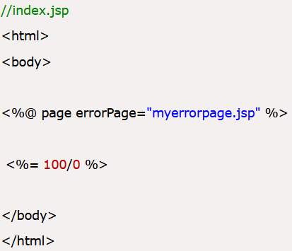
g. isThreadSafe :
Servlet and JSP both are multithreaded. If you want to control this behavior of JSP page, you can use the isThreadSafe attribute of page directive.
The value of isThreadSafe value is by default true.
If you make it false, the web container will serialize the multiple requests, i.e. it will wait until the JSP finishes responding to a request before passing another request to it.
h. errorPage :
The errorPage attribute is used to define the error page.
If exception occurs in the current page, it will be redirected to the error page.

Slide 28
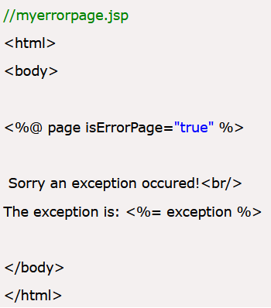
i. isErrorPage
The isErrorPage attribute is used to declare that the current page is the error page.

Slide 29
types of directives continued…
2. Include directive:
The include directive is used to include the contents of any resource like jsp file, html file or text file.
The include directive adds the original content of the included resource at page translation time.
Syntax of include directive:
<%@ include file="resourceName" %>
3. JSP Taglib directive
The JSP taglib directive is used to specify a tag library that defines many tags.
Syntax JSP Taglib directive:
<%@ taglib uri="uri_of_the_tag_library" prefix="prefixoftaglibrary" %>

Slide 30
The Scriptlet
A scriptlet can contain any number of JAVA language statements, variable or method declarations, or expressions that are valid in the page scripting language.
syntax of Scriptlet −
<%
code fragment
%>
Scriplet example for JSP −
<html>
<head><title>Hello World</title></head>
<body>
Hello World!<br/>
<%
out.println("Your IP address is " + request.getRemoteAddr());
%>
</body>
</html>

Slide 31
JSP Declarations
A declaration element declares one or more variables or methods that can be used in Java code of the JSP file.
We must declare the variable or method before you use it in the JSP file.
Syntax for JSP Declarations −
<%! Declaration_initialization; %>
Example for JSP Declarations −
<%! int i = 0; %>
<%! int a, b, c; %>
<%! Circle a = new Circle(2.0); %>

Slide 32
JSP Expression
A JSP expression element contains a scripting language expression that is evaluated, then converted to a String, and inserted as text wherever the expression appears in the JSP file.
We cannot use a semicolon to end an expression.
Syntax of JSP Expression −
<%= expression %>
Example shows a JSP Expression −
<html>
<body>
<%= "Welcome "+ request.getParameter("uname") %>
</body>
</html>

Slide 33
Java Database Connectivity (JDBC)
Java JDBC is a JAVA API to connect and execute queries with the database.
JDBC API uses jdbc drivers to connect with the database.
Before JDBC, ODBC API was the database API to connect and execute query with the database.
But, ODBC API uses odbc driver which is written in C language (i.e. platform dependent and unsecured).
So, Java has defined its own API (JDBC API) that uses JDBC drivers (written in Java language).

Slide 34
JDBC Connectivity with JSP
Software Requirement
MySQL
MySQL Connector (Jar file)
Apache Tomcat Server
Eclipse/ any IDE
Important Note:
Copy MySQL Connector (Jar file) into Tomcat’s Bin and Lib folder
Before running program right click on project name -> Build path -> Configure build path -> Libraries -> Add External Jar file -> browse for Mysql .jar file -> click OK

Slide 35
JDBC Connectivity with JSP-
Create table in database (mysql)
Create the Employee table in the db1 database as follows −
mysql> Create database db1;
mysql> use db1;
mysql> create table emp
(
id int,
name varchar (255)
);
Query OK, 0 rows affected (0.08 sec)

Slide 36
JDBC Connectivity with JSP-
Add rows in database (mysql)
Insert Data:
mysql> Insert into emp values (100, 'Ankit'');
mysql> Insert into emp values (101, 'Tushar');

Slide 37
JSP Code in Eclipse
Click File menu->New->Web->Dynamic Web Project->Give a Project Name
Right click on Project name->New->package->Give package name For Writing JSP Code
Project Name-> Right click->New->JSP file-> Give file name with .jsp extension
In <body> tag write java connectivity code inside scriptlet tag
<%
// connectivity code
%>
Right click on .jsp file -> Run -> Run as Server

Slide 38
JDBC Connectivity with JSP-
Example 1- JSP Code to select data from emp table
<%@ page import ="java.sql.*" %>
<%@ page import ="javax.sql.*" %>
<HTML><BODY>
<%
Class.forName("com.mysql.jdbc.Driver");
Connection con = DriverManager.getConnection("jdbc:mysql://localhost:3306/db1","root","root"); Statement st= con.createStatement();
ResultSet rs=st.executeQuery("select * from emp");
out.print("<h2 align=center>Employee Database</h2>");
out.print("<table border=1 align=center>");
out.print("<tr><th> EmpNo</th> <th>EName</th></tr>");

Slide 39
JDBC Connectivity with JSP-
Example 1- JSP Code for to select data from emp table
while(rs.next())
{
out.print("<tr align=center>");
out.print("<td>"); out.print(rs.getInt(1)); out.print("</td>");
out.print("<td>"); out.print(rs.getString(2)); out.print("</td>");
out.print("</tr>");
}
%>
</HTML></BODY>

Slide 40
JDBC Connectivity with JSP-
Example 2- JSP Code for insert data in emp table and display the inserted data from table
It requires 2 files:
S1.html (Html file to take values from user)
S2.jsp (JSP file to insert data in database and to display the inserted data)

Slide 41
JDBC Connectivity with JSP-
Example 2- JSP Code for insert data in emp table and display the inserted data from table
S1.html
<html>
<body>
<form method="post" action=“S2">
Enter Employee No<input type="text" name="t1"><br>
Enter Empoyee Name <input type="text" name="t2"><br>
<input type="submit" value="submit">
</form>
</body>
</html>

Slide 42
JDBC Connectivity with JSP-
Example 2- JSP Code for insert data in emp table and display the inserted data from table
S2.jsp
<%@ page import ="java.sql.*" %>
<%@ page import ="javax.sql.*" %>
<HTML><BODY>
<%
Class.forName("com.mysql.jdbc.Driver"); java.sql.Connection con =
DriverManager.getConnection("jdbc:mysql://localhost:3307/db1","root","root");
Statement st= con.createStatement();
int id= Integer.parseInt(request.getParameter("t1")); String name= request.getParameter("t2");
st.executeUpdate("insert into emp values("+id+",' "+name+" ')");

Slide 43
JDBC Connectivity with JSP-
ResultSet rs=st.executeQuery("select * from emp");
out.print("<h2 align=center>Employee Database</h2>"); out.print("<table border=1 align=center>"); out.print("<tr><th> EmpNo</th><th>EName</th></tr>"); while(rs.next())
{
out.print("<tr align=center>"); out.print("<td>"); out.print(rs.getInt(1)); out.print("</td>");
out.print("<td>"); out.print(rs.getString(2)); out.print("</td>");
out.print("</tr>");
}
%> </HTML></BODY>

Slide 44
JSP Action tags
With the JSP’s scripting elements we can provide JAVA code inside JSP pages.
But, the main intension of JSP technology is to reduce the JAVA code.
Thus, JSP Action tags are used as alternative to some JAVA code in JSP (scripting element in JSP)
The JSP technology provides some standard actions in the form of some pre-defined Action Tags
With JSP standard actions, we can dynamically include a file, reuse JavaBeans components, forward the client request to another page, or generate HTML for the Java plugin.
Syntax :
<jsp:action_name attribute = "value" />

Slide 45
JSP Actions
S.No. | Syntax & Purpose
1 | <jsp:include> - Includes a file at the time the page is requested.
2 | <jsp:param> - To define a parameter for other relevant JSP action tags
3 | <jsp:useBean> - Finds or instantiates a JavaBean.
4 | <jsp:setProperty> - Sets the property of a JavaBean.
5 | <jsp:getProperty > - Inserts the property of a JavaBean into the output.
6 | <jsp:forward> - Forwards the request to a new page.
7 | <jsp:plugin> - Generates browser-specific code that makes an OBJECT or EMBED tag for the Java plugin.
8 | <jsp:element> - Defines XML elements dynamically.
9 | <jsp:attribute> - Defines dynamically-defined XML element's attribute.
10 | <jsp:body> - Defines dynamically-defined XML element's body.
11 | <jsp:text> - Used to write template text in JSP pages and documents.

Slide 46
<jsp:useBean> action tag
The <jsp:useBean> action tag is used to locate or instantiate a JAVA bean class (i.e. create object & get reference to Java Bean class).
If bean object of any bean class is already created, it doesn't create the bean (depending on the scope).
But, if object of bean class is not created, then it instantiates the bean class.
Syntax of <jsp:useBean> action tag :
<jsp:useBean id= "instanceName"
scope= "page | request | session | application"
class= "packageName.className"
type= "packageName.className" >
</jsp:useBean>

Slide 47
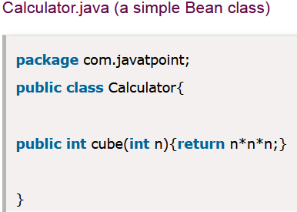
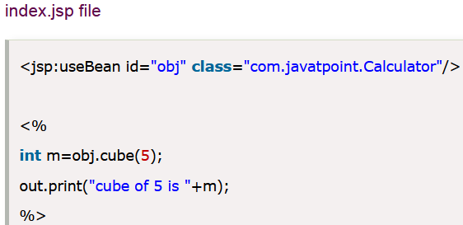
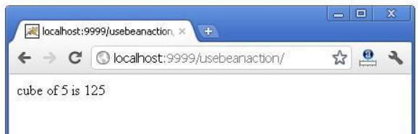
Example of jsp:useBean action tag

Slide 48
<jsp:setProperty> action tag
After we create the bean object, we need to set data for it’s
properties/features/variables.
The <jsp:setProperty> action tag is used to set value for a particular property of the bean class object.
Syntax of <jsp:setProperty> action tag :
<jsp:setProperty name=" " property=" " value=" " />
NOTE:
name: it is the id attribute’s value from the <jsp:useBean> tag
property: property name of bean class to which value is to be assigned by executing respective setter method (Eg. setName(“Anand”) )
value: value to be assigned to the specified property by executing respective setter method of bean class

Slide 49
<jsp:getProperty> action tag
<jsp:getProperty> action tag is used to access the current value of a particular property of the bean class object.
Syntax of <jsp:getProperty> action tag :
<jsp:getProperty name=" " property=" " />
NOTE:
name: id attribute’s value from the <jsp:useBean> tag
property: property name whose value we want to get by executing respective getter method (Eg. getName() )
<jsp:setProperty> and <jsp:getProperty> tags are always used as child tags to <jsp:useBean> tag

Slide 50
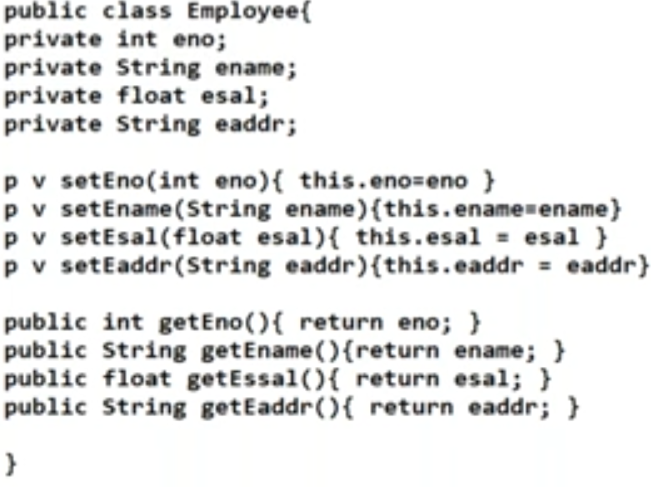

Slide 51
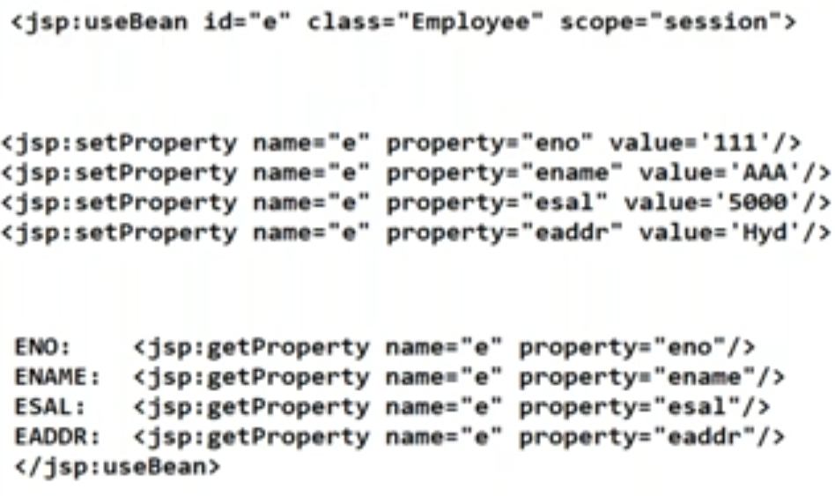

Slide 52
jsp:forward action tag
The <jsp:forward> action tag is used to forward the request to another resource it may be jsp, servlet, html or any other resource.
Syntax of jsp:forward action tag without parameter :
<jsp:forward page="relativeURL | <%= expression %>" />
Syntax of jsp:forward action tag with parameter :
<jsp:forward page="relativeURL | <%= expression %> " >
<jsp:param name="parametername" value="parametervalue" | <%=expression%>" />
</jsp:forward>

Slide 53
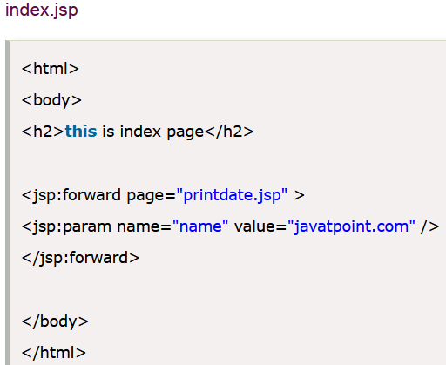
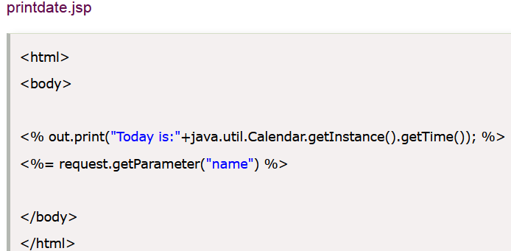

Slide 54
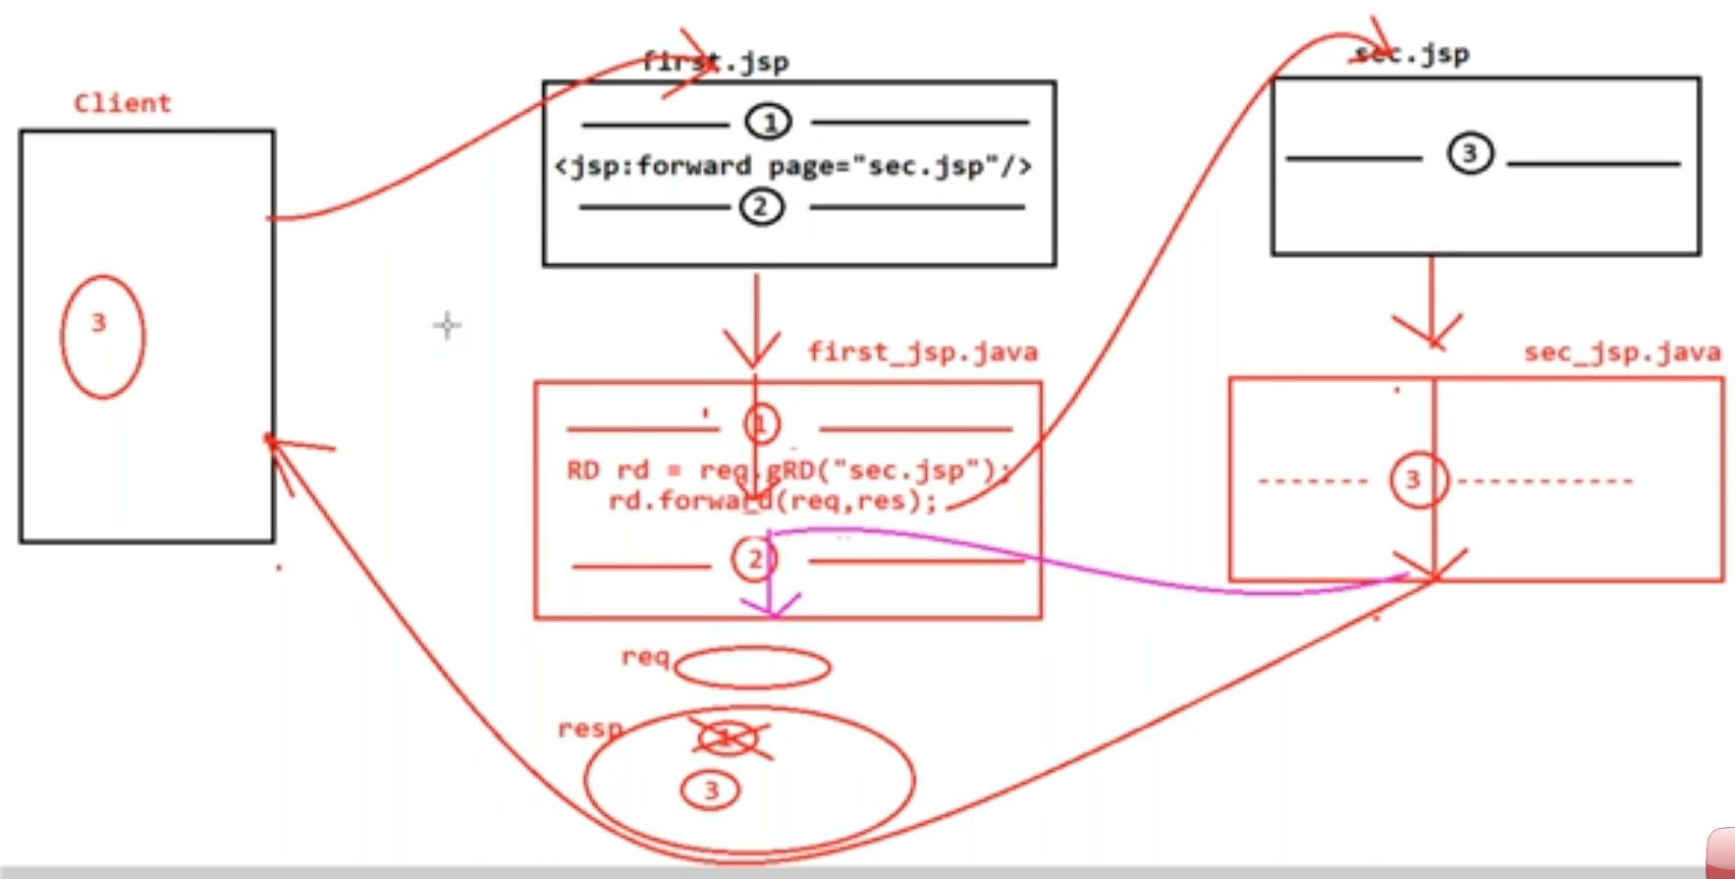
Working mechanism of <jsp:forward>

Slide 55
<jsp:include> action tag
The <jsp:include> action tag is used to include the content of another resource at the request time (resource may be jsp, html or servlet )
The jsp:include tag can be used to include static as well as dynamic pages:
jsp:include action tag without parameter:
<jsp:include page="relativeURL" | <%= expression %>" />
jsp:include action tag with parameter :
<jsp:include page="relativeURL" | <%= expression %>">
<jsp:param name="parametername" value="parametervalue" | <%=expression%>" />
</jsp:include>

Slide 56
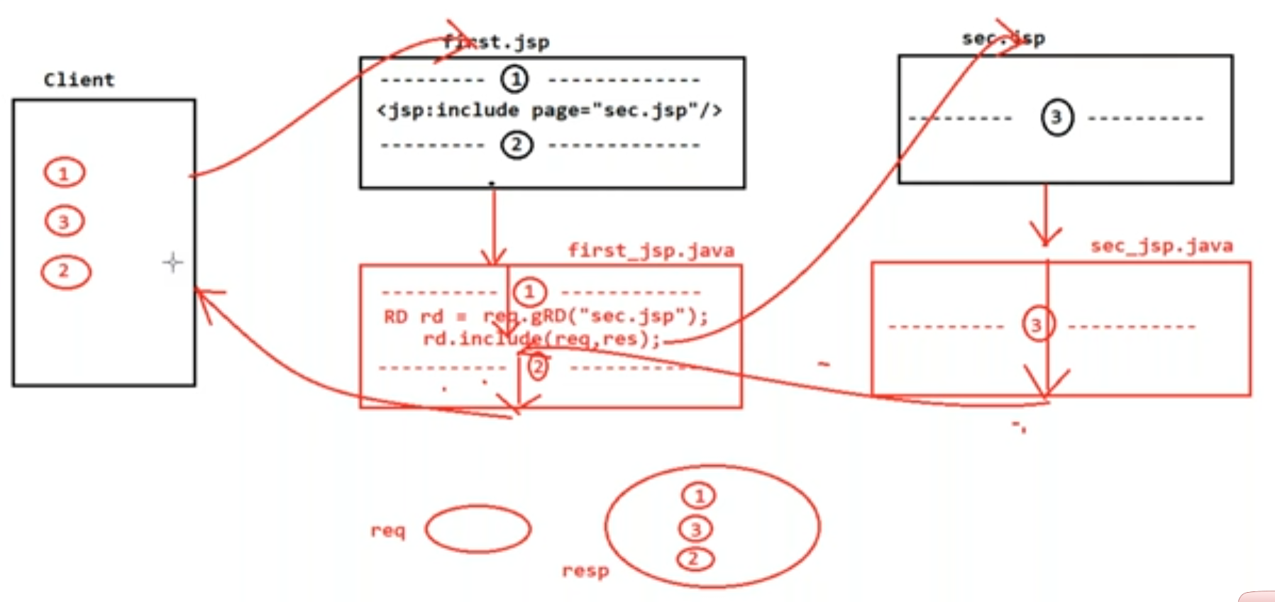
Working mechanism of <jsp:include>

Slide 57
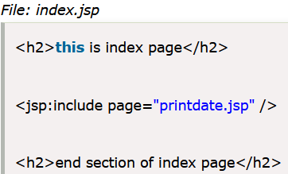

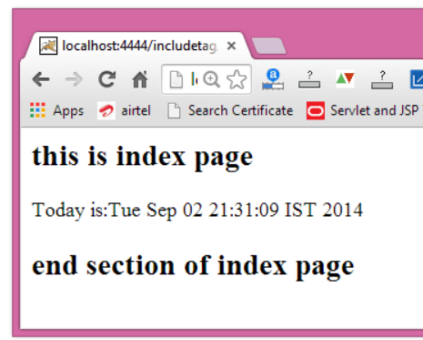
Example of <jsp:include> action tag

Slide 58
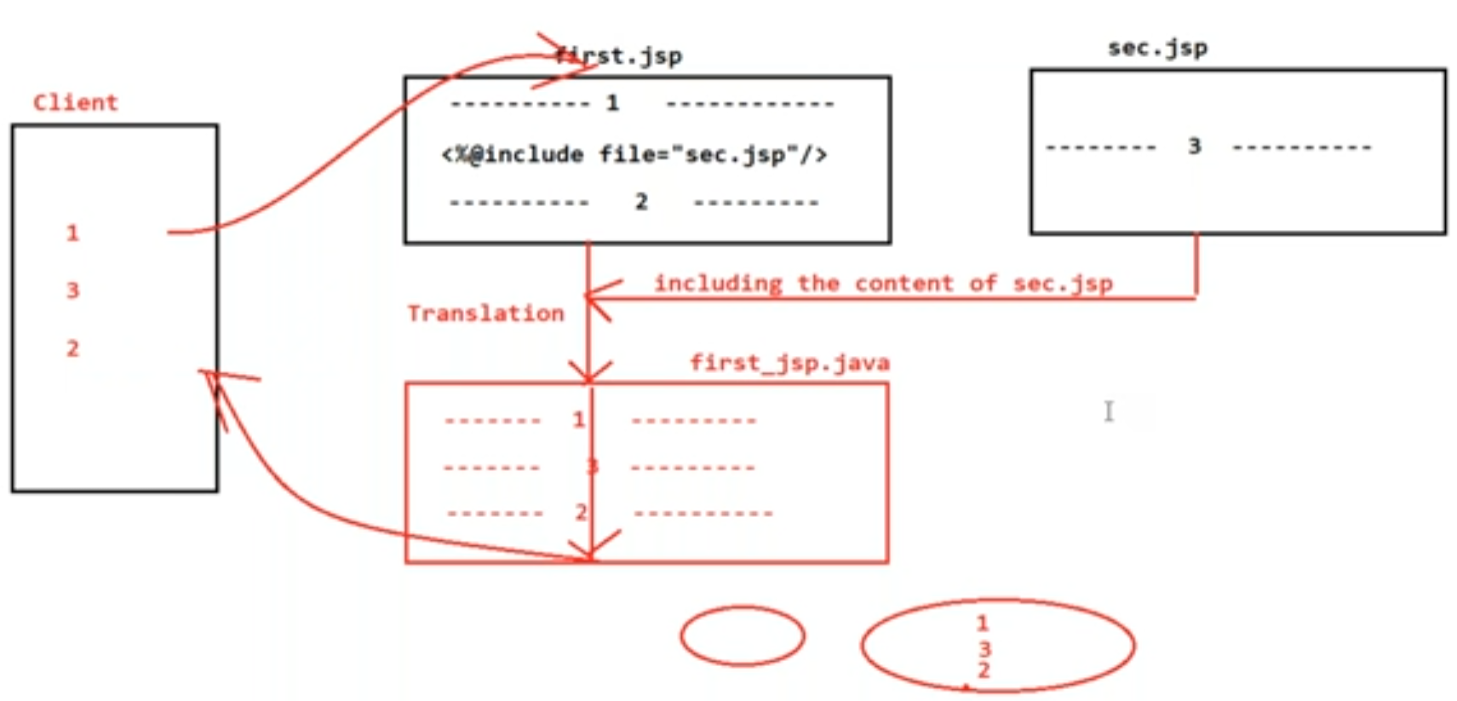
<%@include > Vs <jsp:include>
It is Static inclusion versus Dynamic inclusion of any target resource
Static or Translation time inclusion of Target resource’s “Content”

Slide 59
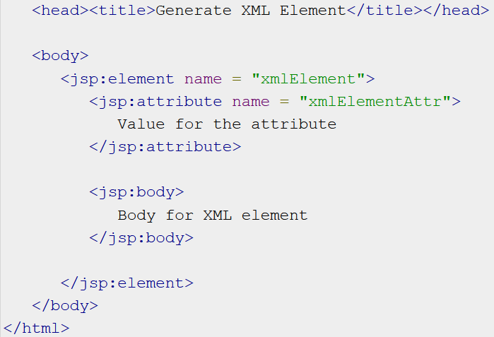
<jsp:element>, <jsp:attribute> and <jsp:body> actions tags
They are used to define XML elements dynamically.

Slide 60
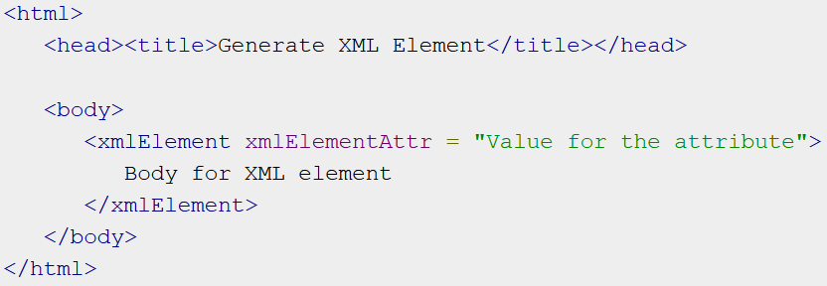

Slide 61
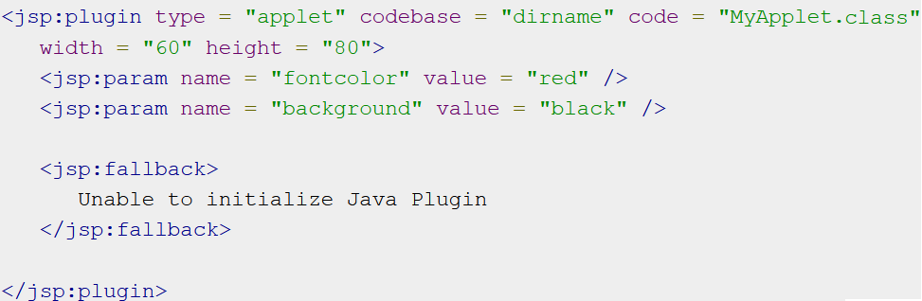
<jsp:plugin> & <jsp:fallback> action tag
The <jsp:plugin> action tag is used to insert Java components
into a JSP page.
The Java component can be an Applet loaded into JSP page.
<jsp:fallback> tag is used to specify an error string to be sent
to the client in case the component fails (Eg. applet load fails).

Slide 62
JSP Templates

Slide 63
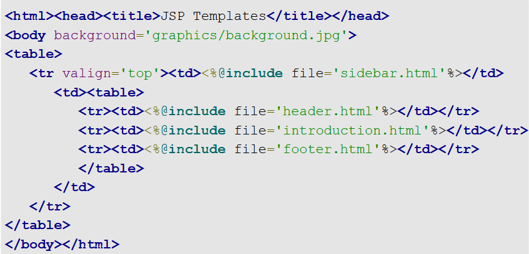
The content is included with the JSP include directive, which allows the content of the page to vary.
However, since the layout is always hard coded, any layout changes will require modifications to the page.
If a Website has multiple pages with identical formats (which is common) then, even simple layout changes require modifications to all of the pages.

Slide 64
continued…
So, to minimize the impact of layout changes, we need a mechanism for including layout in addition to content.
Hence, both layout and content can vary without modifying the files that use them.
This mechanism is JSP templates. (Same like CSS in HTML)
Templates are JSP files that include parameterized content.
The templates have a set of custom tags:
template:get
template:put
template:insert

Slide 65
Example of JSP Templates
The template is included with template:insert
template:put puts the bean in request scope
A bean contains the URI (Uniform Resource Identifier) of a Web component
<template:insert template='/articleTemplate.jsp'>
<template:put name='header' content='/header.html' />
<template:put name='sidebar' content='/sidebar.jsp' />
<template:put name='content' content='/introduction.html' />
<template:put name='footer' content='/footer.html' />
</template:insert>
template:get retrieves a Java bean with the specified name
<template:get name='header'/>
<template:get name='content'/>
<template:get name='footer'/>

Slide 66
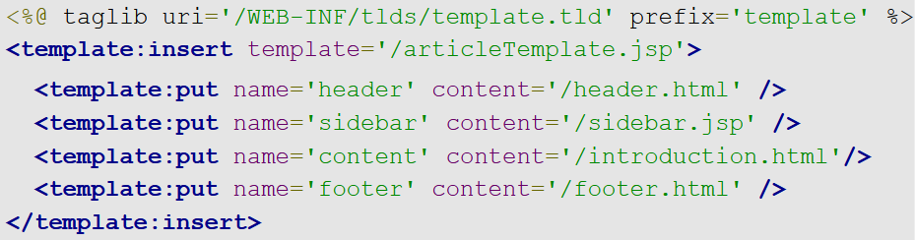
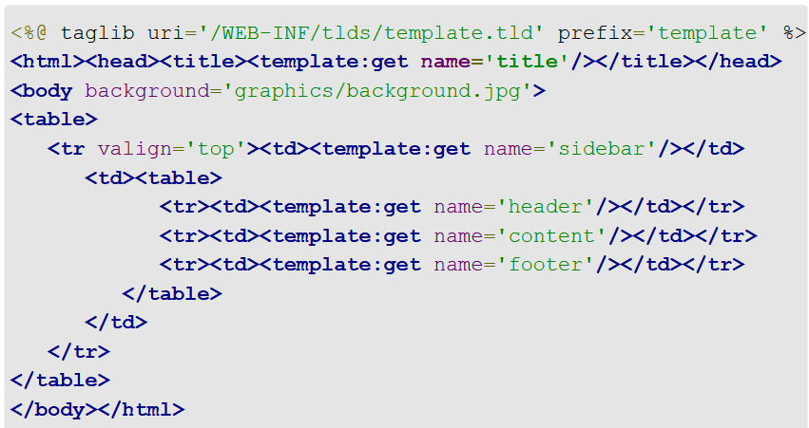

Slide 67
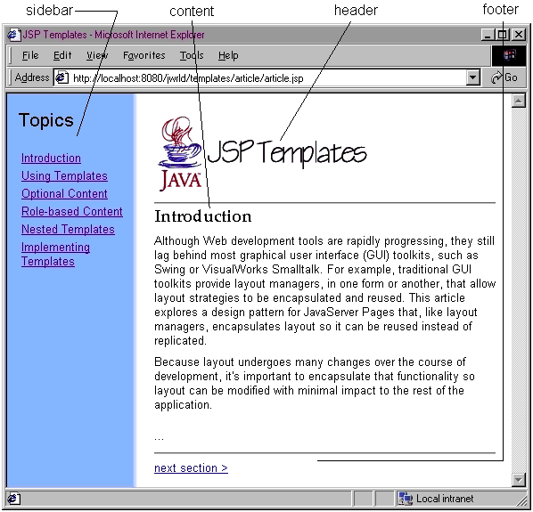

Slide 68
Link for JSP quiz:
https://forms.office.com/r/HGNHGnwmYq

Slide 69
Web Services

Slide 70
Web Services: Overview
A Web Service can be defined by following ways:
is a client server application or application component for communication which can be available over the Internet or private (intranet) networks.
is a method of communication between two devices over network.
is a collection of standards or protocols for exchanging information between two devices or applications.
Web services use a standardized XML messaging system

Slide 71
Components of Web Services
The basic web services platform is XML + HTTP.
All the standard web services work using the following components −
SOAP (Simple Object Access Protocol)
WSDL (Web Services Description Language)
UDDI (Universal Description, Discovery and Integration)
How Does a Web Service Work?
A web service takes the help of −
XML to tag the data
SOAP to transfer a message
WSDL to describe the availability of service.

Slide 72
Skeleton SOAP Message
<?xml version="1.0"?> <soap:Envelope xmlns: soap="http://www.w3.org/2003/05/soap-envelope/" soap: encodingStyle="http://www.w3.org/2003/05/soap-encoding"> <soap:Header> ... holds metadata about the message </soap:Header> <soap:Body> ... holds the actual request or response data <soap:Fault> ... holds error information </soap:Fault> </soap:Body> </soap:Envelope>

Slide 73
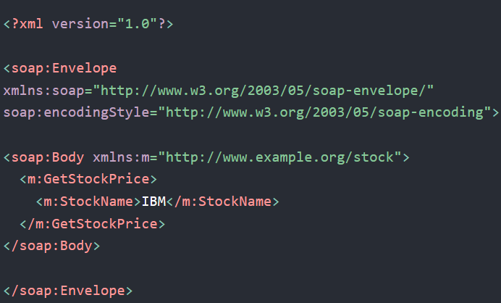
A SOAP Example
In the example, a GetStockPrice request is sent to a server.
The request has a StockName parameter and a Price parameter that will be returned in the response.

Slide 74
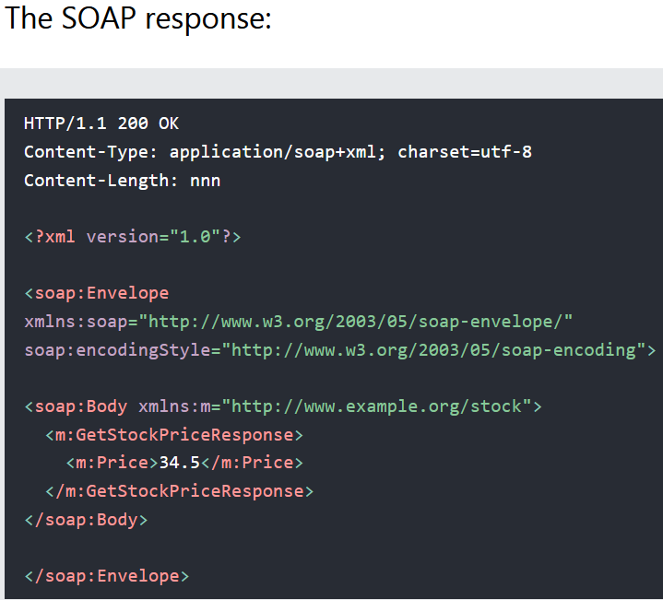

Slide 75
2. WSDL (Web Services Description Language):
WSDL is an XML-based language for describing web services. It defines:
Location of the web service (where it is hosted).
Data format used for communication.
Methods (operations) the web service provides.
How WSDL Works
A client reads the WSDL file to understand how to interact with the service.
The client generates SOAP requests based on the operations defined in WSDL.
The server responds with SOAP messages using the same format defined in WSDL.

Slide 76
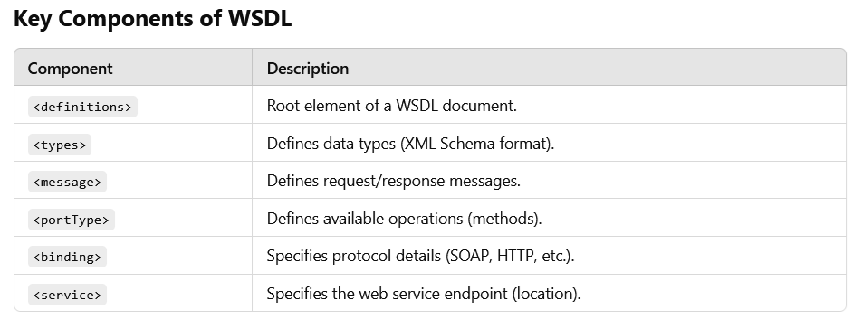

Slide 77
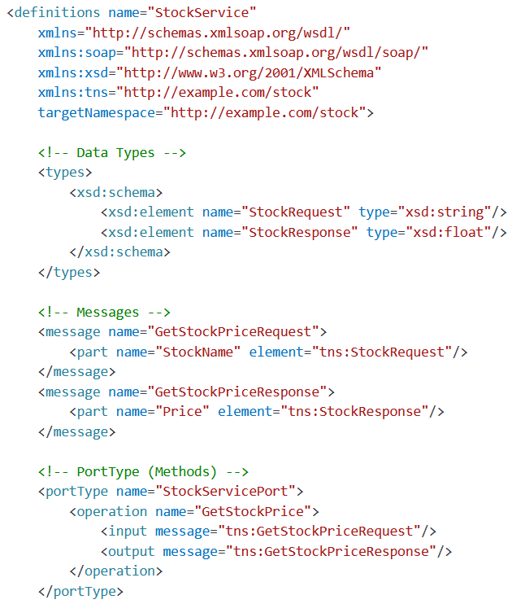
StockService WSDL example

Slide 78
Steps to create a SOAP Web service

Slide 79
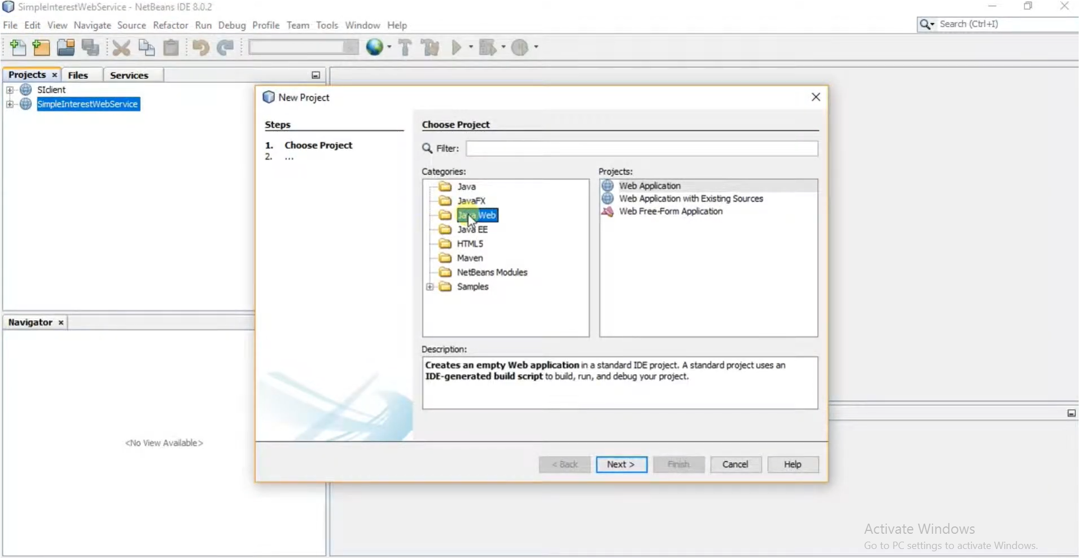
1.Create web application for web service

Slide 80
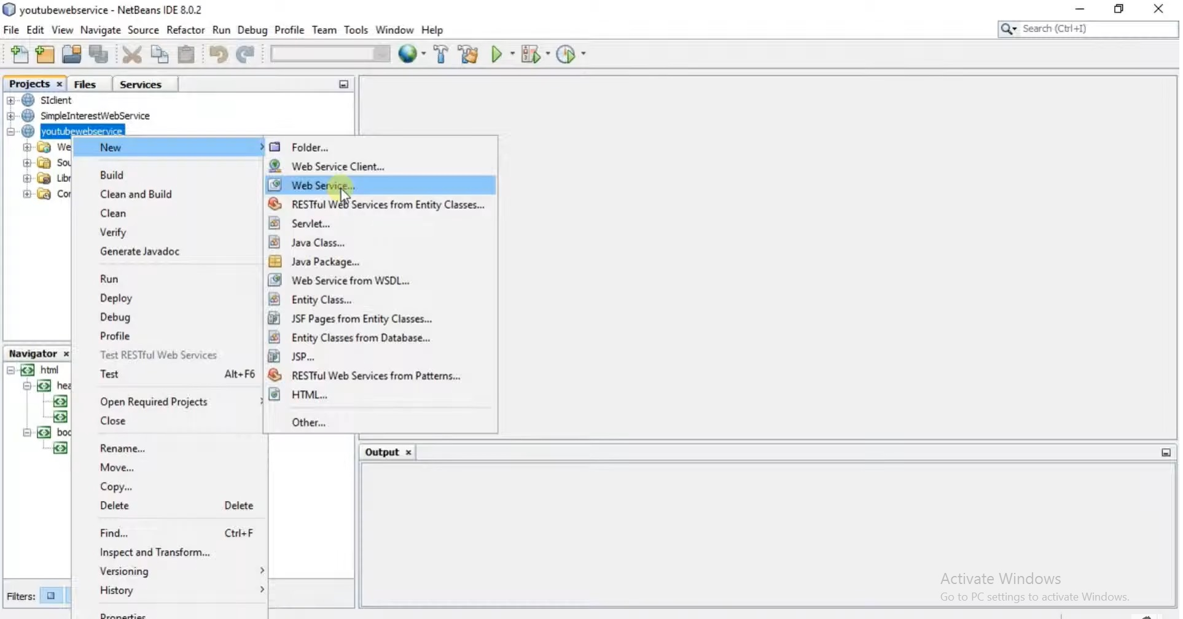
2.Create a web service

Slide 81
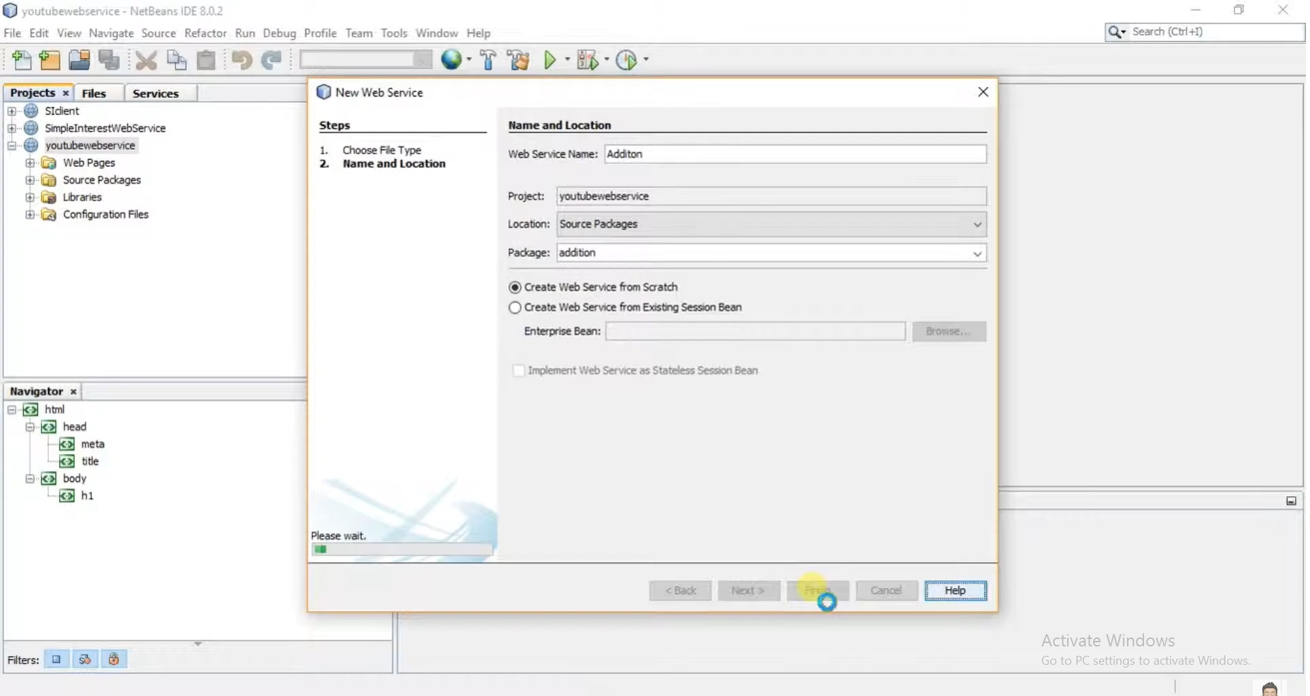
3.Give name & package to the web service

Slide 82
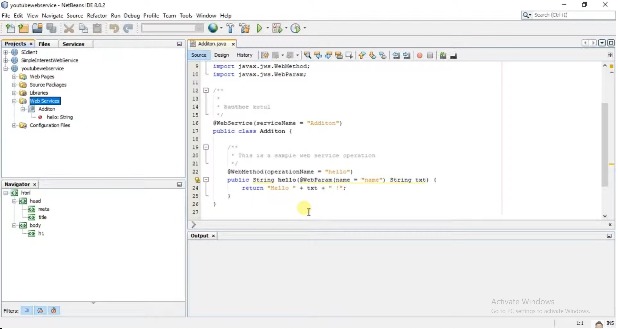

Slide 83
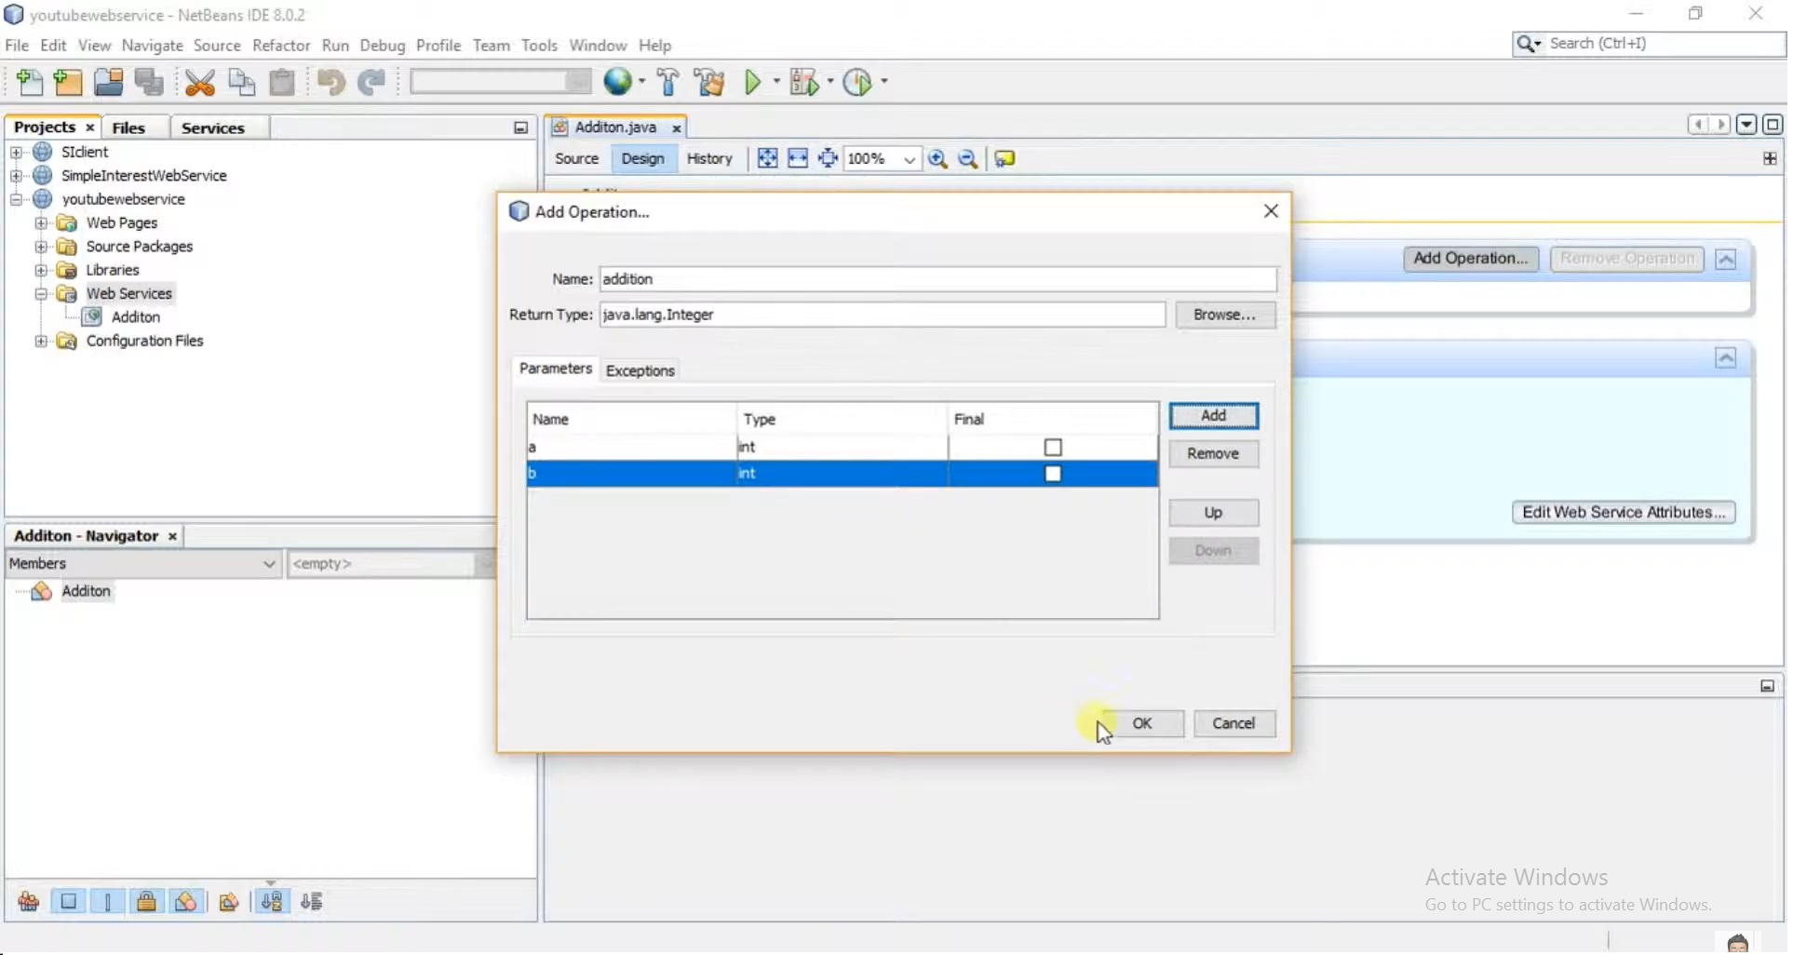
4. Add an operation to the service

Slide 84
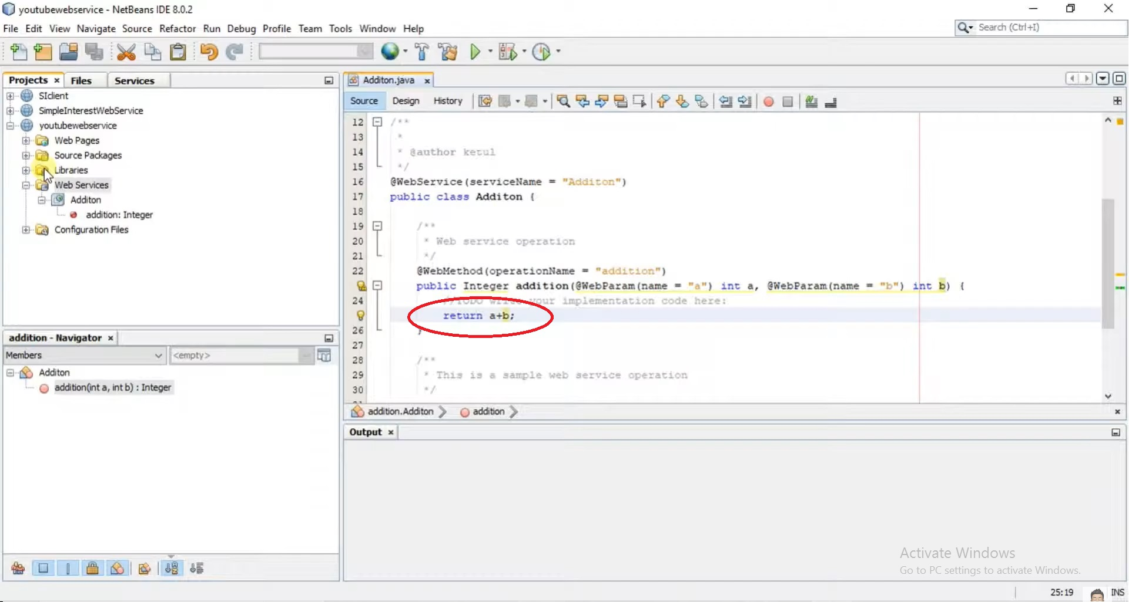

Slide 85
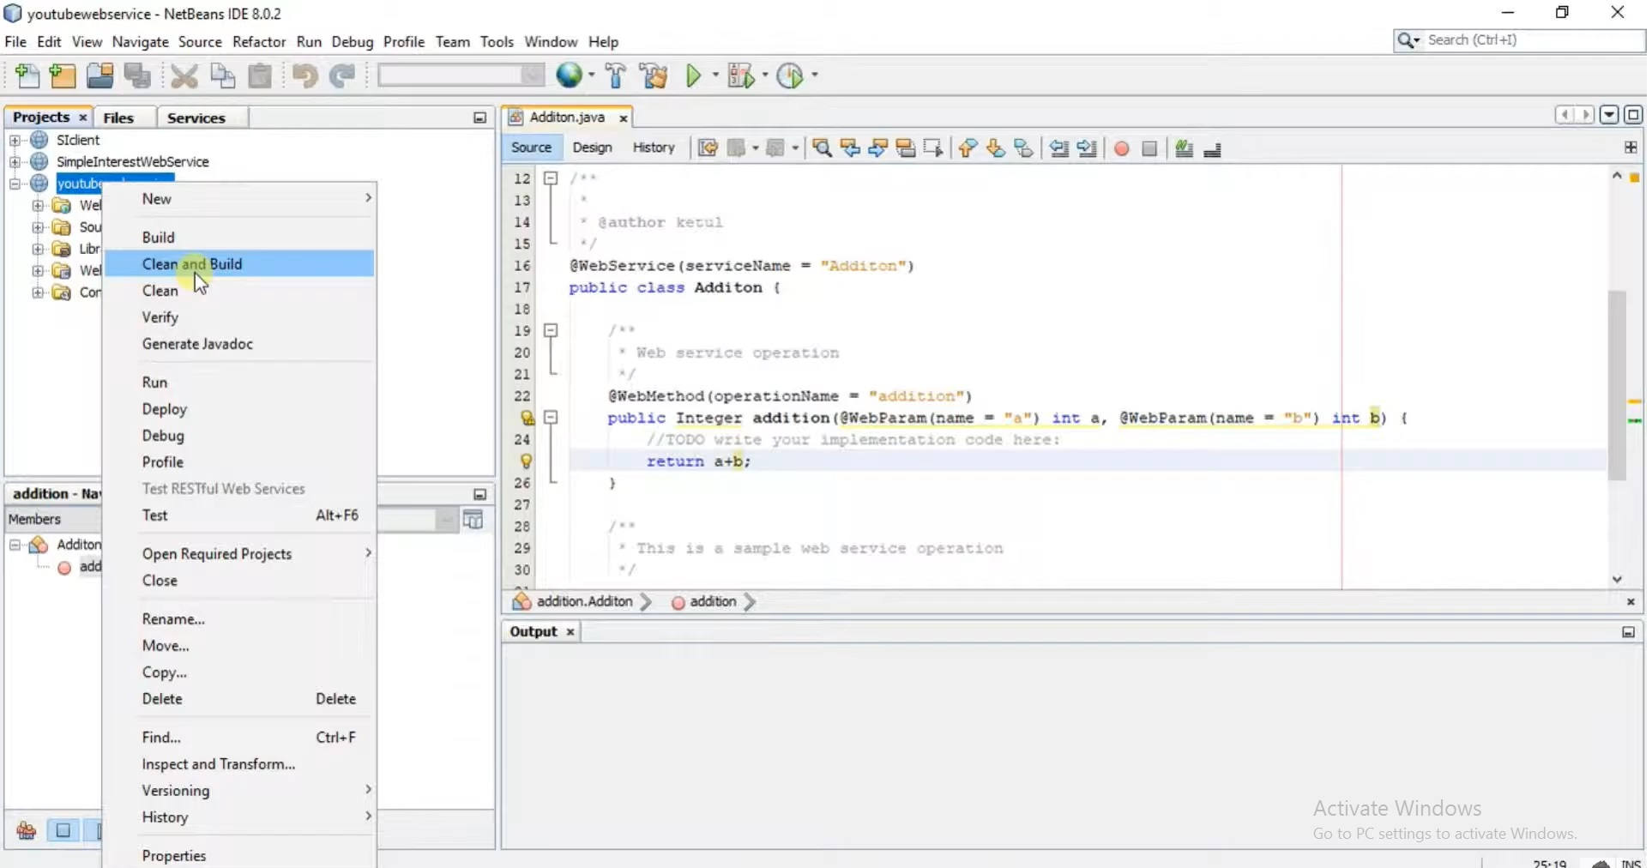
5. Clean & build

Slide 86
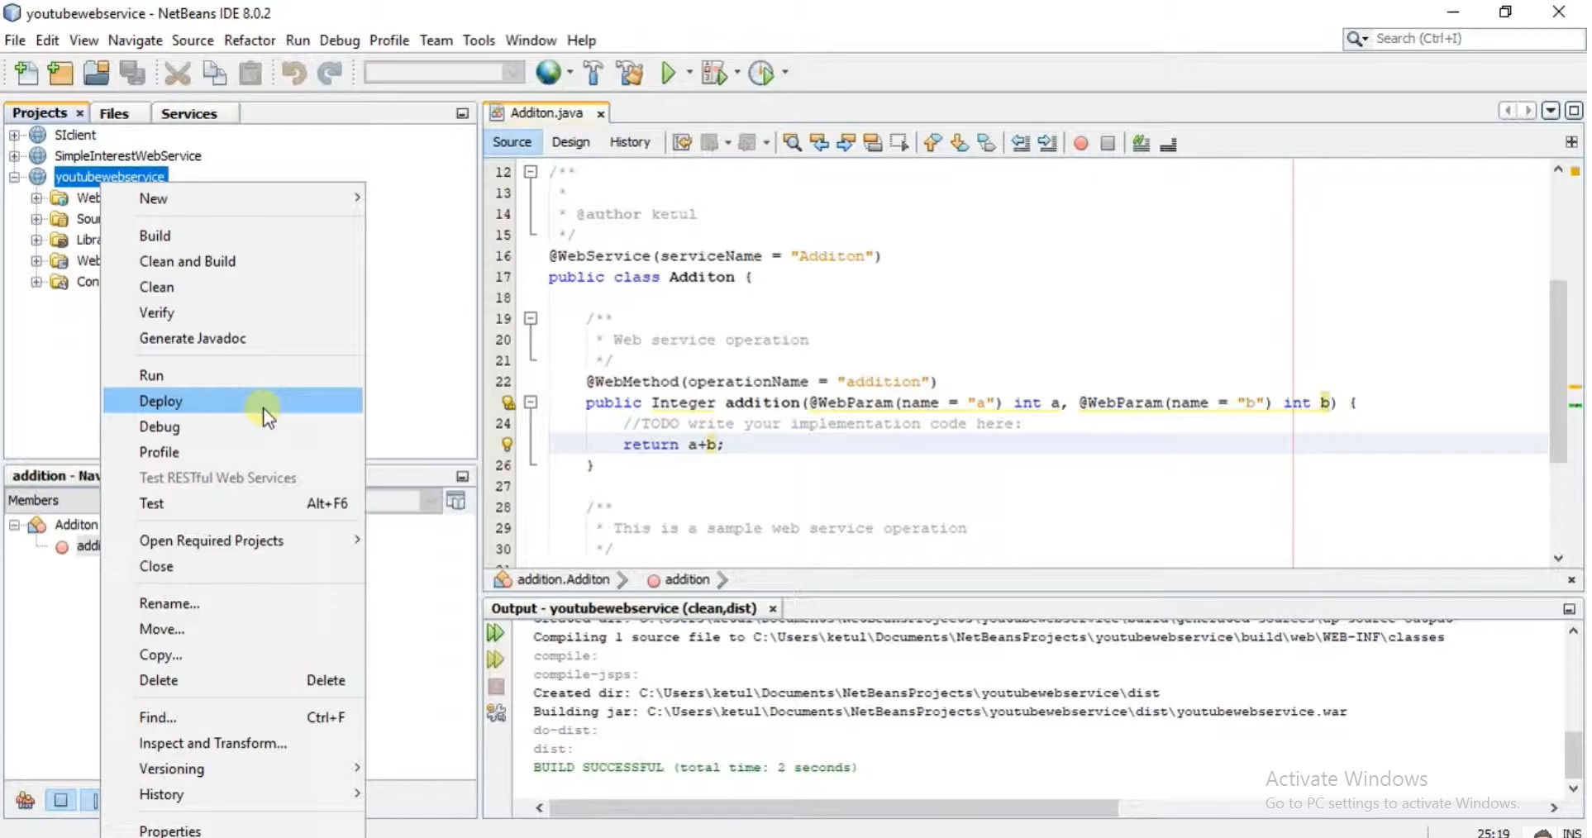
6. Deploy

Slide 87
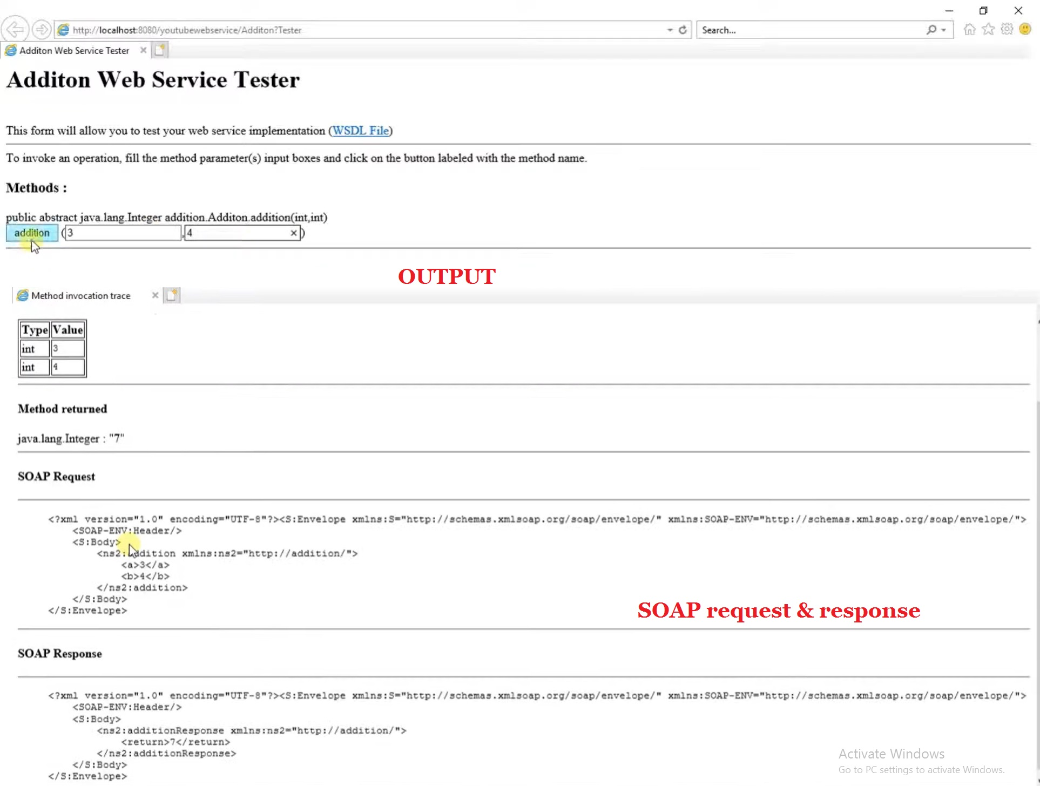
7. Using the web-service

Slide 88
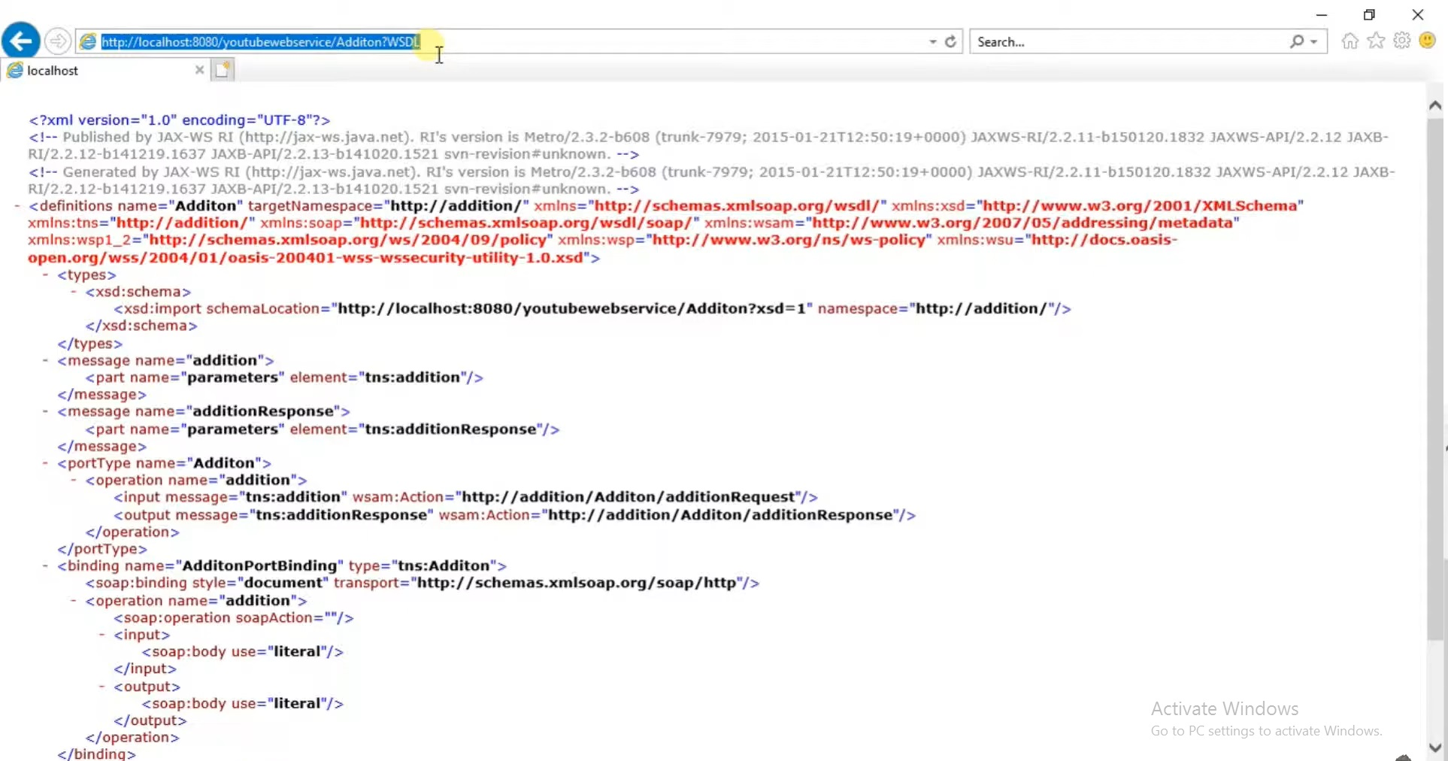
WSDL

Slide 89
Steps to create a consumer client for web service

Slide 90
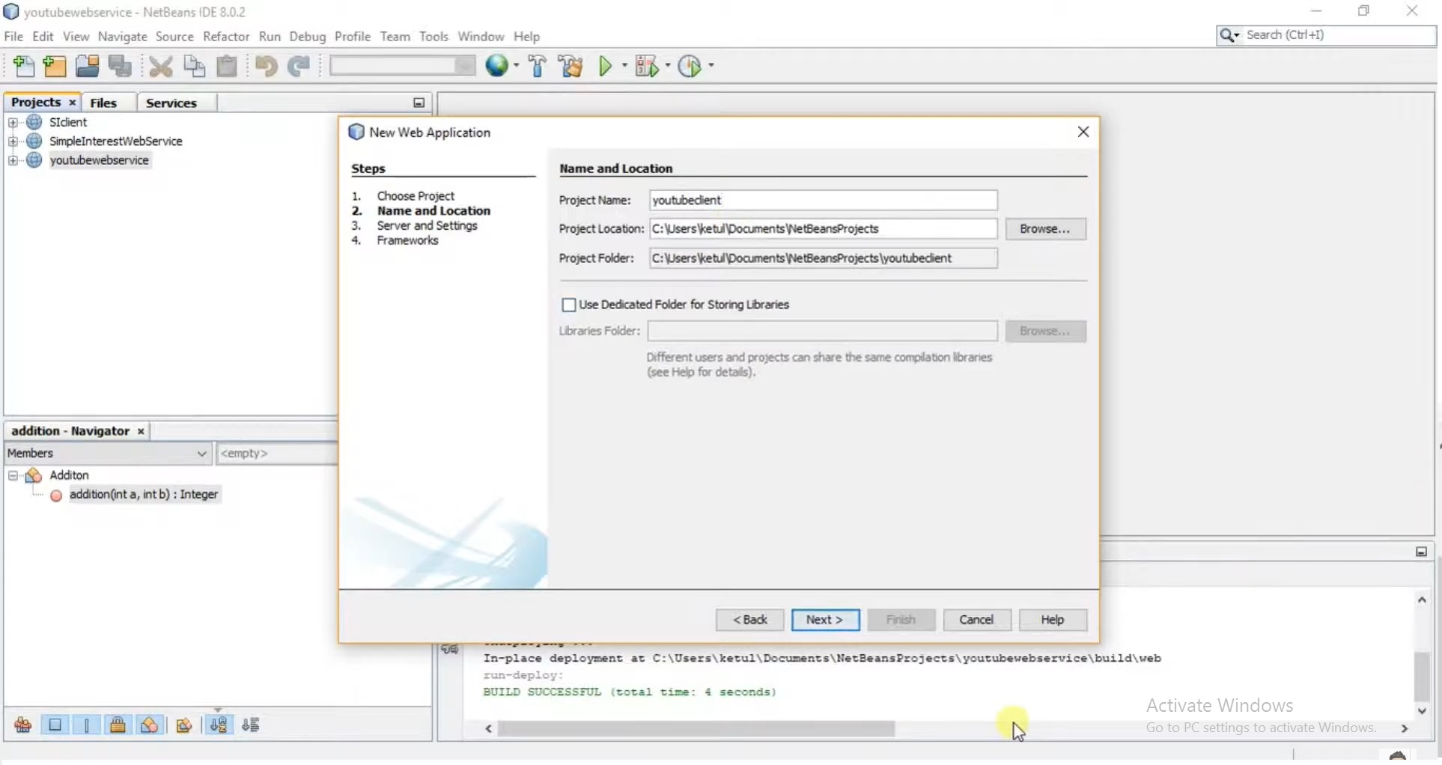
1. Create web application for client

Slide 91
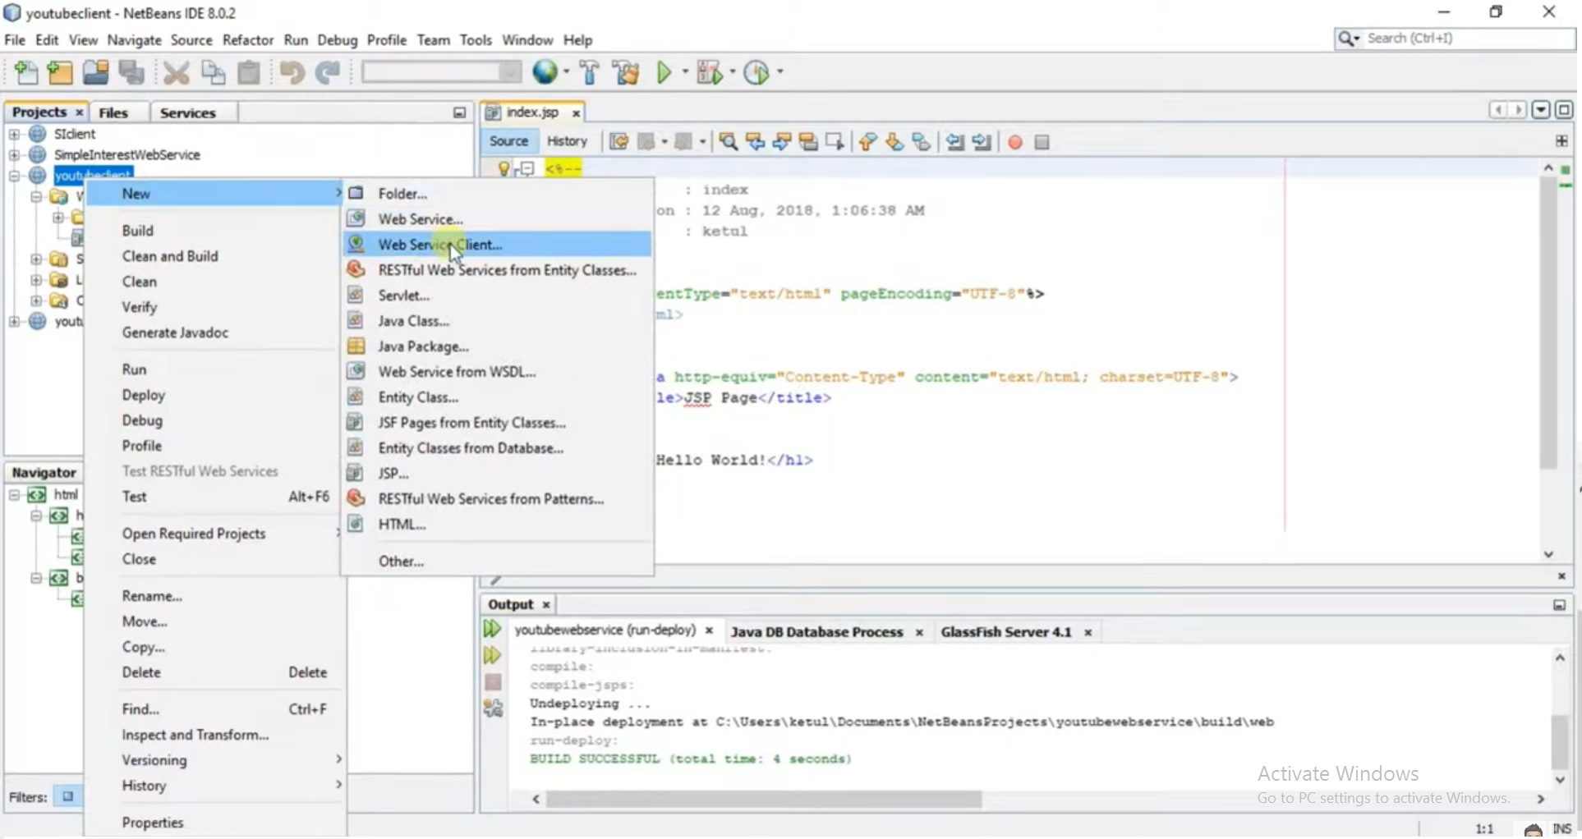
2. Create web service client

Slide 92
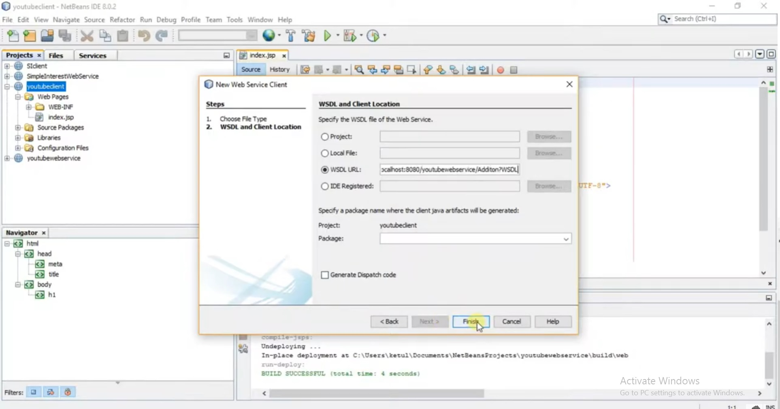
3. Paste the WSDL URL

Slide 93
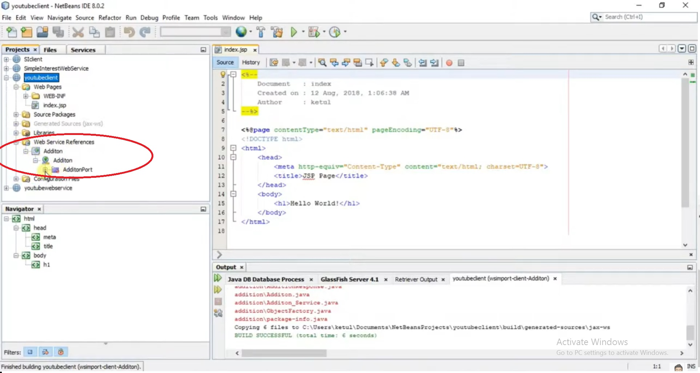
4. Web service operations are now visible

Slide 94

5. Create HTML form for web client

Slide 95

6. Set the web service operation to be called

Slide 96

7. Operations available to the client, select one service

Slide 97

8. Replace operation code

Slide 98


Slide 99


